Slide 1

Academic Session 2025-26
Even Semester Jan-May 2025
UNIVERSITY INSTITUTE OF ENGINEERING
AIT-CSE (AIML)
CS221: B.E. CSE (AIML)
5th Semester
ADVANCED MACHINE LEARNING & MATHEMATICAL MODELLING
(23CSH-382)
Unit No. 1 Chapter No. 1 Lecture No. 3, 4 & 5
Topic : Fundamental Terminologies for Regression
Mr. Siddharth Kumar (E12853) Assistant Professor

Slide 2
COURSE OBJECTIVES
1
The course aims to:
To develop a strong mathematical foundation for regression-based predictive modelling using calculus, matrix algebra, and probability theory.
To provide an in-depth understanding of supervised classification algorithms including KNN, Support Vector Machines, and ensemble-based boosting approaches.
To equip learners to implement clustering and probabilistic reasoning models such as Spectral Clustering, Markov Chains, Bayesian Networks, and HMMs.
To cultivate the ability to design neural networks, implement multilayer perceptron, and optimize training using backpropagation and regularization strategies.
To expose students to advanced deep learning frameworks, feature abstraction hierarchies, and performance enhancement through hyper-parameter tuning & dropout.

Slide 3

COURSE OUTCOMES
2
On completion of this course, the students shall be able to:
CO1 | Recall the foundational concepts, terminology, and mathematical principles underlying regression, classification and clustering approaches.
CO2 | Illustrate the working mechanisms, characteristics, and theoretical concept of regression, clustering and classification techniques in machine learning.
CO3 | Apply appropriate regression, clustering and classification algorithms to solve real-world machine learning tasks while addressing performance constraints.
CO4 | Analyze and evaluate machine learning models using performance parameters to identify the best-suited techniques for specific applications regression, clustering and classification algorithms.
CO5 | Design and implement optimized machine learning solutions by integrating regression, clustering and classification models to solve complex predictive and decision-making problems.

Slide 4
Unit-I Syllabus
3
Unit-1 | Regression | Contact Hours: 15
Regression | Linear and Polynomial Regression, Maxima and Minima of Function of One Variable, Rank, Eigen Values and Eigen Vectors, Positive & Negative Definite/Semi-definite Matrices
Error Estimation | Maxima and Minima of Function of Several Variables, Convexity of Errors Function, Building Simple Linear Regression Model by Solving Normal Equations, Gradient Descent, Stochastic & Mini-batch Gradient Descent Algorithm
Probability Theory | Discrete Probability Distributions, Continuous Probability Distributions, Normal Distribution and t-Distributions, RSE, R²

Slide 5
SUGGESTIVE READINGS
4
Text Books / Reference Books:
TEXT BOOKS
T1: Massaron, L., & Boschetti, A. (2016). Regression analysis with Python. Packt Publishing Ltd.
T2: Jajuga, K., Sokolowski, A., & Bock, H. H. (Eds.). (2012). Classification, clustering, and data analysis: recent advances and applications.
T3: Bishop, C. M., & Bishop, H. (2023). Deep learning: Foundations and concepts. Springer Nature.
REFERENCE BOOKS
R1: Matloff, N. (2017). Statistical regression and classification: from linear models to machine learning. Chapman and Hall/CRC.
R2: Jajuga, K., Sokolowski, A., & Bock, H. H. (Eds.). (2012). Classification, clustering, and data analysis: recent advances and applications.
R3: Vishnoi, V. K., Chauhan, N. R., & Kumar, K. (2024). An introduction to deep learning. Xoffencer publication.

Slide 6
Table of Contents
5
Maxima and Minima of Function of One Variable
Rank
Eigen Values and Eigen Vectors
Positive & Negative Definite
Semi-Definite Matrices

Slide 7
Maxima and Minima of Function of One Variable
6
Maxima and Minima refer to the highest and lowest points of a function's graph, respectively, within a given domain.
These points are also called turning points since the slope of the function (derivative) becomes zero at these positions.
Maximum: A point where the function's value is higher than that of all nearby points. It can be:
Local Maximum: The function value is higher than in its immediate neighborhood.
Global Maximum: The function value is higher than at any other point in the domain.

Slide 8
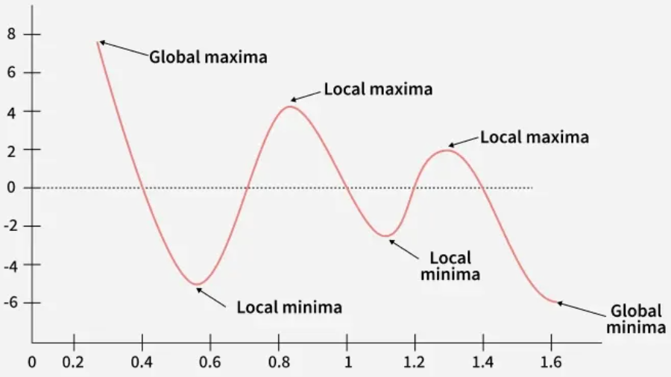
Maxima and Minima of Function of One Variable
7
Figure-1: Maxima & Minima

Slide 9
Maxima and Minima of Function of One Variable
8
Minimum: A point where the function's value is lower than that of all nearby points. It can be:
Local Minimum: The function value is lower than in its immediate neighborhood.
Global Minimum: The function value is the lowest among all points in the domain.
Mathematically, for a function f(x), a point x₀ is:
A local maximum if f(x₀) > f(x) for all x near x₀​.
A local minimum if f(x₀) < f(x) for all x near x₀​.

Slide 10
Maxima and Minima of Function of One Variable
9
Types of Maxima and Minima
There are two types of maxima and minima. They are listed as follows:
Relative or Local Maxima and Minima
Absolute or Global Maxima and Minima
Relative Maxima and Minima: The relative maxima and minima are the maximum and minimum values which is greater than or less than its neighbor.
Relative or Local Maxima: A function f(x) is said to have a relative maximum at x = a if there exists a neighborhood (a - δa, a + δa) of a such that
f(x) < f(a) for all x ∈ (a-δa, a+δa), x ≠ a.

Slide 11
Maxima and Minima of Function of One Variable
10
Here, the point a is called the point of relative maxima of a function and f(a) is called as the relative maximum value. The relative maxima is also called as the local maxima of a function.
Relative or Local Minima: A function f(x) is said to have a relative minimum at x = a if there exists a neighborhood (a-δa, a+δa) of a such that
f(x) > f(a) for all x ∈ (a-δa, a+δa), x ≠ a.
Here, the point a is called the point of minima of a function and f(a) is called as the relative minimum value.
The relative minima is also called as the local minima of a function.

Slide 12
Maxima and Minima of Function of One Variable
11
Absolute Maxima and Absolute Minima: It is the highest or the lowest value in the entire domain of the function.
Absolute Maxima: A function f(x) with domain D is said to be absolute maximum at x = a where a ∈ D, if f(x) ≤ f(a) for all x ∈ D. The point a is called the point of absolute maxima of function and f(a) is called as the absolute maximum value. The absolute maxima is also called as the global maxima of a function.
Absolute Minima: A function f(x) with domain D is said to be absolute maximum at x = a where a ∈ D , if f(x) ≥ f(a) for all x ∈ D. The point a is called the point of absolute maxima of function and f(a) is called as the absolute maximum value.
The absolute maxima is also called as the global maxima of a function.

Slide 13
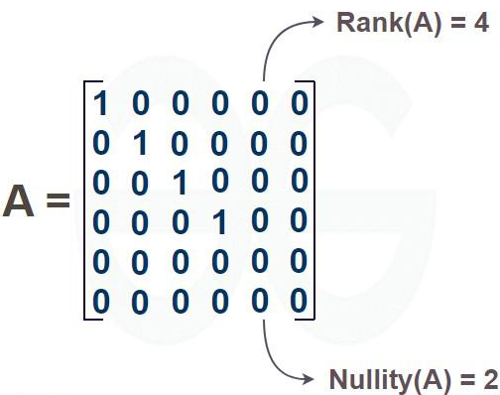
Rank in a Matrix
12
The Rank of a Matrix is the maximum number of linearly independent rows or columns in a matrix. It essentially determines the dimensionality of the vector space formed by the rows or columns of the matrix.
It helps determine:
If a system of linear equations has solutions.
The "usefulness" of rows or columns contributes to the matrix's information.

Slide 14
Rank in a Matrix
13
The rank of a matrix is denoted using ρ(A), where A is any matrix. Thus, the number of rows of a matrix is a limit on the rank of the matrix, which means the rank of the matrix cannot exceed the total number of rows in a matrix.
If a matrix is of the order 3×3, then the maximum rank of a matrix can be 3.
Note: If a matrix has all rows with zero elements, then the rank of a matrix is to be zero.
Nullity of Matrix
In a given matrix, the number of vectors in the null space is called the nullity of the matrix, or it can also be defined as the dimension of the null space of the given matrix.
Total columns in a matrix = Rank + Nullity

Slide 15
Rank in a Matrix
14
Finding Rank of a Matrix
To find the rank of a matrix using the minor method, the following steps are followed:
Calculate the determinant of the matrix (say A). If det(A) ≠ 0, then the rank of matrix A = order of matrix A.
If det(A) = 0, then the rank of the matrix is equal to the order of the maximum possible nonzero minor of the matrix.

Slide 16
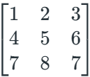
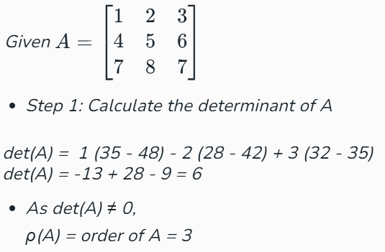
Rank in a Matrix
15
Example: Find the rank of a matrix

Slide 17
Rank in a Matrix
16
Properties of Rank of a Matrix: The properties of the rank of a matrix are as follows:
The rank of a matrix is equal to the order of the matrix if it is a non-singular matrix.
The rank of a matrix is equal to the number of non-zero rows if it is in Echelon Form.
The rank of a matrix is equal to the order of the identity matrix in it if it is in normal form.
Rank of matrix < Order of matrix if it is a singular matrix.
Rank of matrix < minimum {m, n} if it is a rectangular matrix of order m x n.
The rank of the identity matrix is equal to the order of the identity matrix.
The rank of a zero matrix or a null matrix is zero.

Slide 18

Rank in a Matrix
17
Use of Rank of a Matrix in Machine Learning
Checking linear independence of features
The rank of the data matrix 𝑋 (rows = samples, columns = features) tells how many linearly independent features you actually have.
If rank < number of features → some features are linearly dependent (one feature can be written as a combination of others).
Uniqueness of regression solution
In linear regression, the normal equation is:
For (𝑋^{𝑇}𝑋 to be invertible, the matrix 𝑋X must have full column rank.
If rank is not full → no unique solution

Slide 19
Rank in a Matrix
18
Detecting multicollinearity
Low rank (or nearly low rank) indicates multicollinearity: features are highly correlated.
This causes large variance in parameter estimates and poor generalization.
Rank gives a mathematical way to detect such redundancy.
Data quality & redundancy check
Rank deficiency can indicate duplicate or redundant rows/columns in the dataset.
Helps in data cleaning: removing perfectly correlated or duplicate features.

Slide 20
Eigen Values and Eigen Vectors
19
Eigenvalues and eigenvectors are fundamental concepts in linear algebra, used in various applications such as matrix diagonalization, stability analysis, and data analysis (e.g., Principal Component Analysis).
They are associated with a square matrix and provide insights into its properties.
Eigenvalues: Eigenvalues are unique scalar values linked to a matrix or linear transformation. They indicate how much an eigenvector gets stretched or compressed during the transformation. The eigenvector's direction remains unchanged unless the eigenvalue is negative, in which case the direction is simply reversed.
The equation for eigenvalue is given by, Av = λv
Where: A is the matrix, v is associated eigenvector and λ is scalar eigenvalue.

Slide 21
Eigen Values and Eigen Vectors
20
Eigenvectors: Eigenvectors are non-zero vectors that, when multiplied by a matrix, only stretch or shrink without changing direction. The eigenvalue must be found first before the eigenvector. For any square matrix A of order n × n, the eigenvector is a column matrix of size n × 1. This is known as the right eigenvector, as matrix multiplication is not commutative.
Alternatively, the left eigenvector can be found using the equation vA=λv, where v is a row matrix of size 1 × n.
Eigenvector Equation: The Eigenvector equation is the equation that is used to find the eigenvector of any square matrix. The eigenvector equation is Av = λv

Slide 22
Eigen Values and Eigen Vectors
21
How to Find an Eigenvector
The eigenvector of the following square matrix can be easily calculated using the steps below,
Step 1: Find the eigenvalues of the matrix A, using the equation det |(A – λI| =0, where “I” is the identity matrix of order similar to matrix A
Step 2: The value obtained in Step 1 are named as, λ1​,λ2​,λ3​….
Step 3: Find the eigenvector (X) associated with the eigenvalue λ1 using the equation, (A–λ1​I)X=0
Step 4: Repeat step 3 to find the eigenvector associated with other remaining eigenvalues λ2​,λ3​….

Slide 23
Eigen Values and Eigen Vectors
22
Eigenvalues and eigenvectors are fundamental concepts in linear algebra, used in various applications such as matrix diagonalization, stability analysis, and data analysis (e.g., Principal Component Analysis).
They are associated with a square matrix and provide insights into its properties.
Eigenvalues: Eigenvalues are unique scalar values linked to a matrix or linear transformation. They indicate how much an eigenvector gets stretched or compressed during the transformation. The eigenvector's direction remains unchanged unless the eigenvalue is negative, in which case the direction is simply reversed.
The equation for eigenvalue is given by, Av = λv
Where: A is the matrix, v is associated eigenvector and λ is scalar eigenvalue.

Slide 24


Positive & Negative Definite/Semi-Definite Matrices
23
Matrices are often analyzed based on how they transform vectors in quadratic forms.
For a square matrix A, consider the quadratic form:
Based on the sign of Q(x), matrices are classified into definite or semi-definite.
1. Positive Definite Matrix
A square matrix A is positive definite (PD) if:

Slide 25

Positive & Negative Definite/Semi-Definite Matrices
24
Properties
All eigenvalues λi > 0
A must be symmetric A = AT
Determinants of leading principal minors > 0
Quadratic form always yields a positive value
Example

Slide 26


Positive & Negative Definite/Semi-Definite Matrices
25
2. Positive Semi-Definite Matrix (PSD)
Matrix A is positive semi-definite if:
Properties
Eigenvalues λi ≥ 0
Symmetric in nature
Quadratic form never negative, but may be zero
Example

Slide 27


Positive & Negative Definite/Semi-Definite Matrices
26
Negative Definite Matrix
Matrix A is negative definite (ND) if:
Properties
All eigenvalues λi < 0
Symmetric matrix
Quadratic form always yields a negative value
Example

Slide 28


Positive & Negative Definite/Semi-Definite Matrices
27
4. Negative Semi-Definite Matrix (NSD)
Matrix A is negative semi-definite if:
Properties
Eigenvalues λi ≤ 0
Quadratic form is always non-positive
May become zero for some non-zero vector
Example

Slide 29
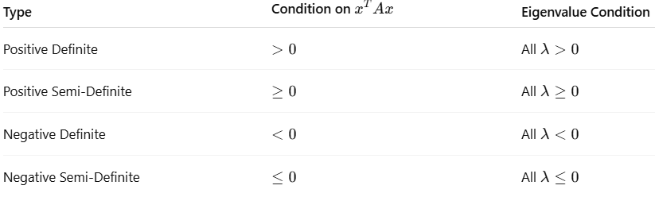
Positive & Negative Definite/Semi-Definite Matrices
28
Quick Summary Table:

Slide 30
Applications of the Topic
29
Here are applications:
The concepts of maxima and minima are widely applied in optimization problems such as minimizing loss functions in machine learning, curve fitting, economics, and engineering system tuning.
Rank, eigenvalues, and eigenvectors are fundamental in areas like Principal Component Analysis (PCA), image compression, vibration analysis, Google PageRank, and stability analysis of linear systems.
Positive and negative definite matrices are crucial in determining the nature of critical points during optimization and are used in quadratic programming, deep learning training, Hessian-based optimization, signal processing, and system control design.

Slide 31
Summary of the Lecture
30
In this lecture, we discussed the Maxima and Minima of a function of one variable and how critical points can be identified using the first derivative while the second derivative test helps determine whether the point is a maximum or minimum.
We further studied the Rank, Eigenvalues and Eigenvectors of matrices where rank represents the number of linearly independent rows or columns, and eigenvalues with their corresponding eigenvectors describe how a matrix scales or transforms a vector concepts widely used in data reduction, stability analysis and machine learning.
Lastly, we covered Positive, Negative Definite and Semi-Definite matrices, which are classified based on the sign of the quadratic form x^{T}Ax, playing an important role in optimization as they help determine the nature of stationary points.

Slide 32
Next Lecture
31
In next lecture, we are going to cover:
Maxima and Minima of Function of Several Variables
Convexity of Errors Function
Building Simple Linear Regression Model by Solving Normal Equations

Slide 33
Quiz/ FAQ’s
32
Define critical point of a function.
What conditions must be satisfied for maxima or minima of a function?
State the first and second derivative test for extrema.
What is the rank of a matrix? How is it determined?
Define eigenvalue and eigenvector.
What is meant by a positive definite matrix?
How is a negative semi-definite matrix different from negative definite?
Can a matrix have both positive and negative eigenvalues? Explain.

Slide 34
References/ Articles/ Videos
33
Text/ Reference Books
T1 | Massaron, L., & Boschetti, A. (2016). Regression analysis with Python. Packt Publishing Ltd.
T2 | Jajuga, K., Sokolowski, A., & Bock, H. H. (Eds.). (2012). Classification, clustering, and data analysis: recent advances and applications.
T3 | Bishop, C. M., & Bishop, H. (2023). Deep learning: Foundations and concepts. Springer Nature.
R1 | Matloff, N. (2017). Statistical regression and classification: from linear models to machine learning. Chapman and Hall/CRC.
R2 | Jajuga, K., Sokolowski, A., & Bock, H. H. (Eds.). (2012). Classification, clustering, and data analysis: recent advances and applications.
R3 | Vishnoi, V. K., Chauhan, N. R., & Kumar, K. (2024). An introduction to deep learning. Xoffencerpublication.

Slide 35
Faculty-curated videos, NPTEL, Coursera, LinkedIn, or other relevant learning resources
34
https://www.coursera.org/learn/ismdl?source=admin-share
https://www.coursera.org/learn/ismdl?source=admin-share
https://www.coursera.org/learn/ai-for-real-world-intelligence-systems?source=admin-share
https://www.coursera.org/learn/ai-for-real-world-intelligence-systems?source=admin-share
https://www.coursera.org/learn/deep-learning-applications-in-vision?source=admin-share
https://www.coursera.org/learn/deep-learning-applications-in-vision?source=admin-share
https://www.coursera.org/learn/ismdl?source=admin-share

Slide 36

35
Class-Wise Feedback
Note: Scan this QR code to provide anonymous feedback.

Slide 37
36
Thank You
For queries
Email: siddharth.e12853@cumail.in

